Slide 1

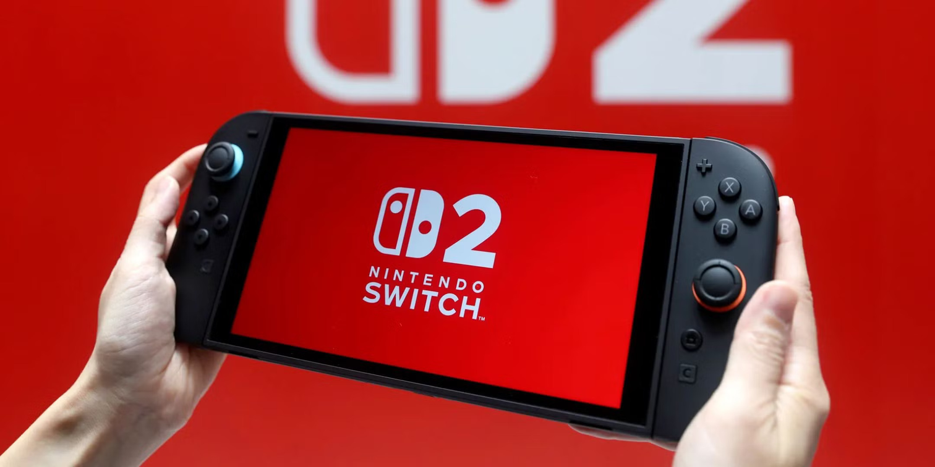


NETNOGRAPHY REPORT:
Group 6: Fausto Durazo, Nathan Jungreis, Nate Kenzler, Taylor Schreiber, Kayleigh Shackford, and Heaven Yoon

Slide 2
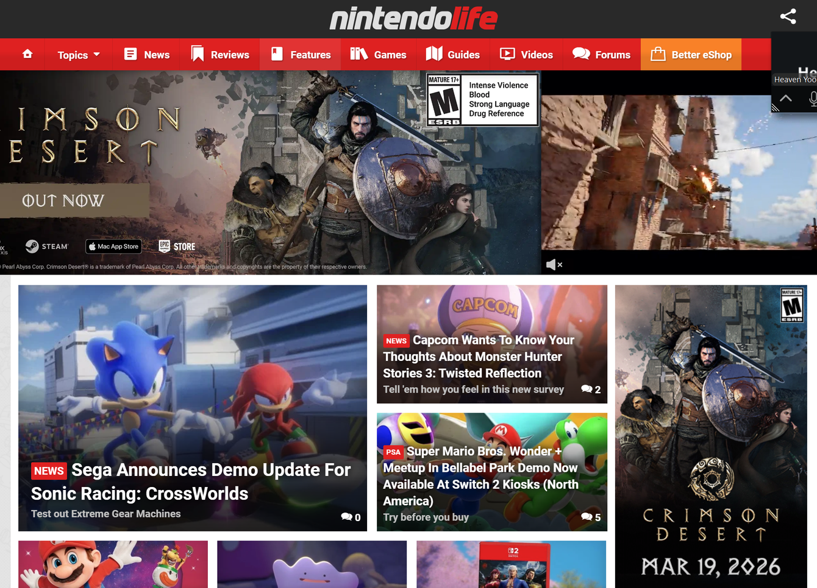
COMMUNITY SELECTION
Nintendo Life - Nintendo Switch 2

Slide 3
RESEARCH QUESTIONS
What do Nintendo Life Switch 2 forum users value most when making gaming decisions (e.g., price, game library, performance, or future releases)?
How does participating in forum discussions alter users’ opinions or decisions about games, consoles, or purchases?
Who are the most influential users in the forum, and what makes their opinions more trusted or persuasive than others?
What shared interests, experiences, or identities create a sense of community among users in the forum?
What key differences (such as play style, opinions on Nintendo, or spending habits) lead to disagreements or division among users?

Slide 4
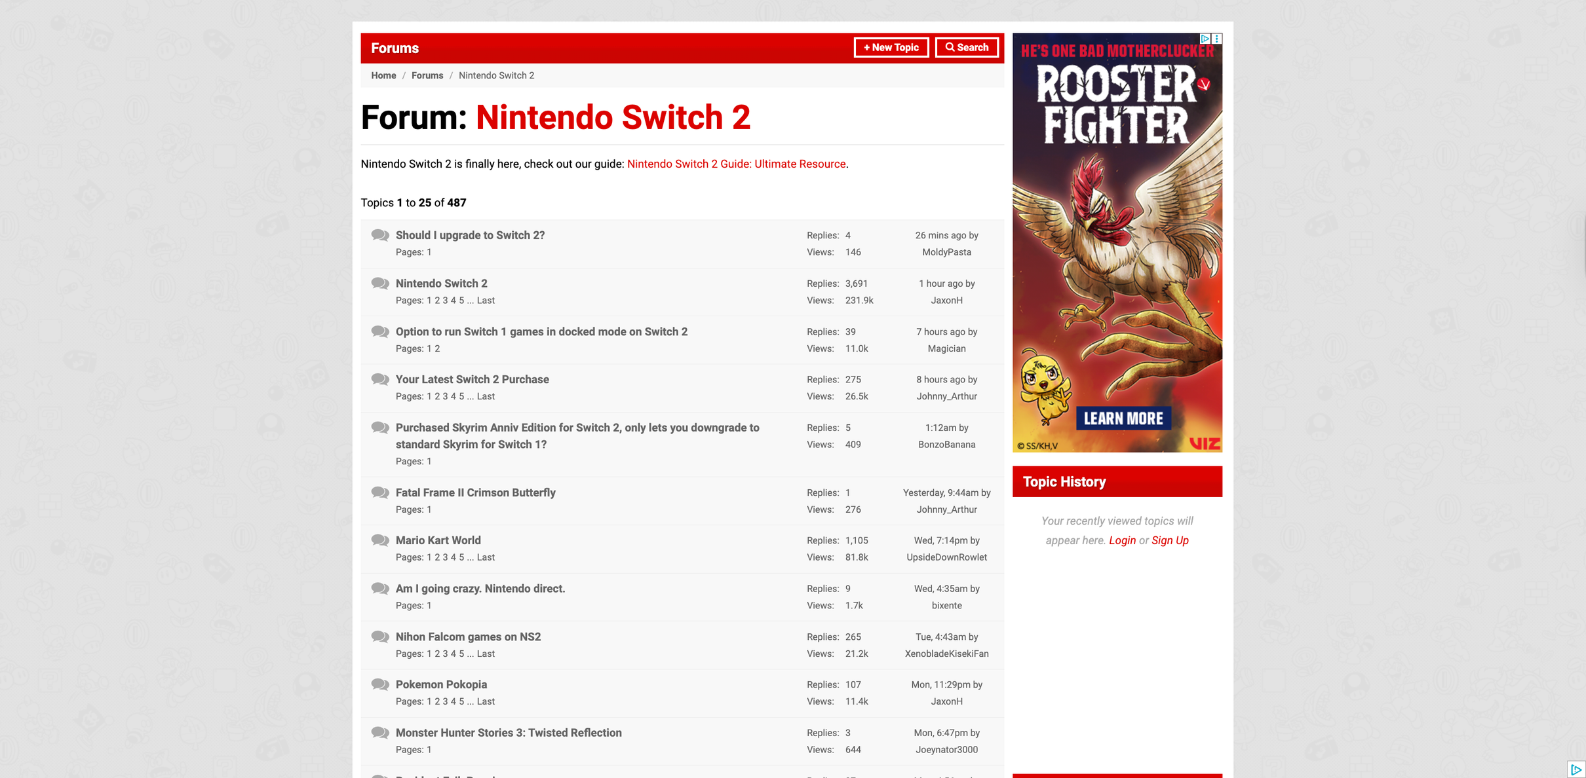
DATA COLLECTED
Number of Topics: 500
Number of Replies: 19,700+ total
Interesting Quotes
“Switch 2 games are more expensive, demand more storage, and battery life is lesser. Unless you've identified at least one or two must-play games, you may as well hold and see what's happening next year.”
“The original post about some buying things they hate, I think has merit. But contorting that to demean all the people who actually enjoy a game you personally disliked, well, that's something else entirely.”
Threads:
Nintendo Switch 2
Should I upgrade to Switch 2?
Pokemon Pokopia

Slide 5


TYPES OF PARTICIPANTS
Insiders
Most users know Nintendo, understand console cycles, and talk comfortably about future titles and hardware. They’re not casual outsiders, but they’ve been around and follow gaming closely.
Devotee
Some users show strong loyalty to Nintendo by talking about future Mario/Zelda/Splatoon like they’re guaranteed buys. They’re more emotionally invested and optimistic.

Slide 6
TYPES OF INTERACTIONS
Geeking
Most interactions are people sharing knowledge and explaining console generations, hardware upgrades, and future game expectations. It’s very info-driven.
Building
Users build on each other’s posts by adding advice, sharing more reasons, and they are generally really supportive. It feels more like people trying to help rather than debating or competing.

Slide 7
RESEARCH SUMMARY RESULTS
Users value price, game library, and how much they’ll actually use the system, with a big influence from future game expectations and whether games will continue to be supported.
There is a high level of technical knowledge from insider-type users, and these experienced users act as informal leaders since their confidence and detailed explanations make others trust their advice.
Because of these knowledgeable users, the forum tends to shape more cautious, informed decisions, especially around whether something is worth buying right now.
The community is built around shared knowledge and discussion, with users regularly helping each other and posting updates about their progress in different games.
Differences come from how people judge value and expectations, especially between those excited for future potential and those who want proven results first.

Slide 8
HYPOTHESIS
If users in the Nintendo Life Switch 2 forum are serious gamers (vs. more casual players), then they are more likely to buy a game or console early and justify it with future games, compared to casual players who would wait and only buy if it seems worth it.
If users in the Nintendo Life Switch 2 forum are more well-versed in Nintendo games (vs. not well-versed), then they are more likely to have an easier time interacting and understanding posts within the community, compared to casual gamers who might get overwhelmed.
If users in the Pokémon forum see a new feature that looks cool but isn’t clearly proven (vs. one that clearly adds to gameplay), then they will look at past games and other people’s opinions to decide if it’s actually good or just a gimmick.

Slide 9
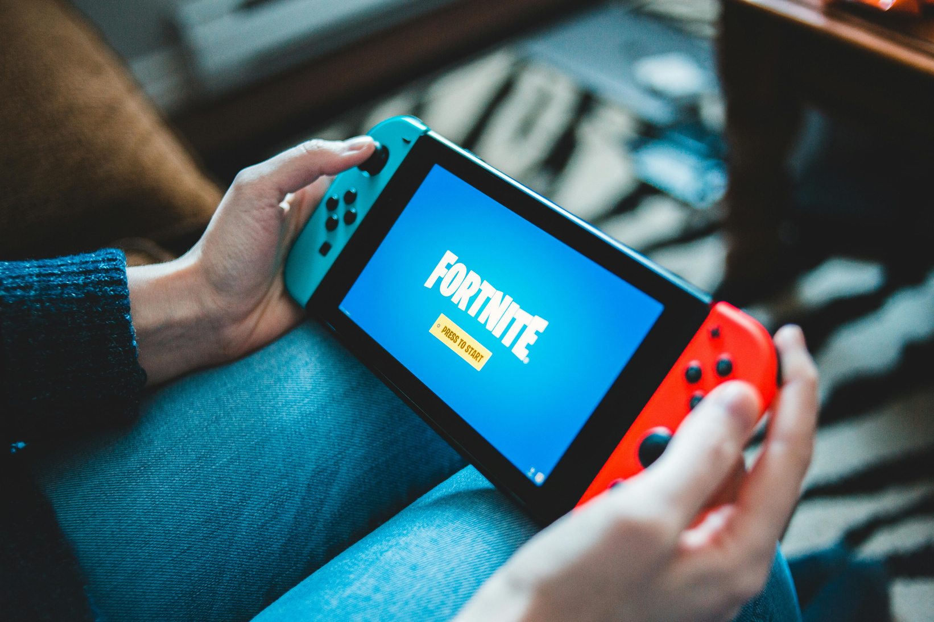
APPENDIX

Slide 10
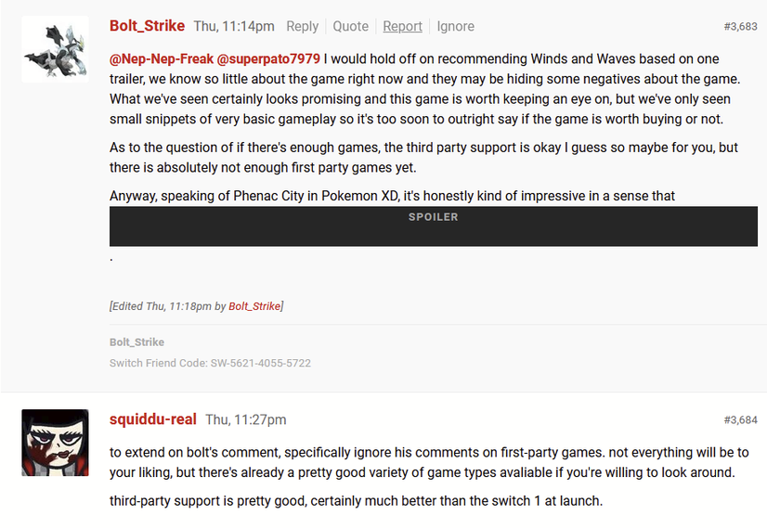
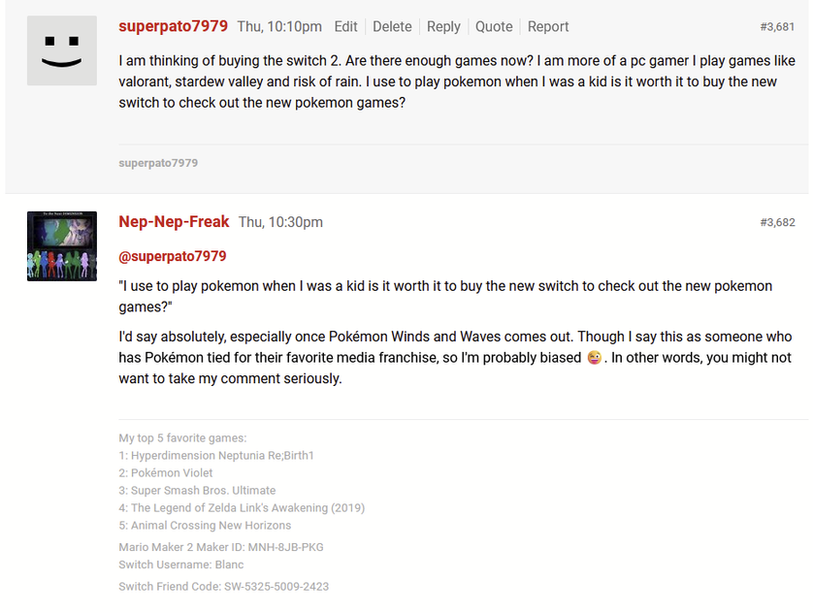
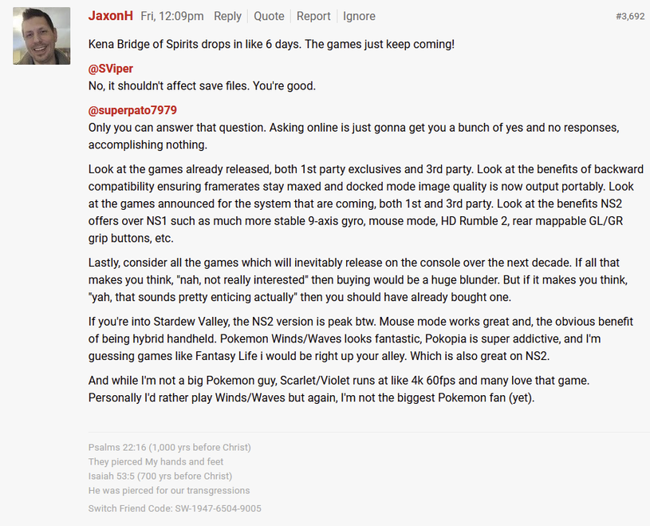
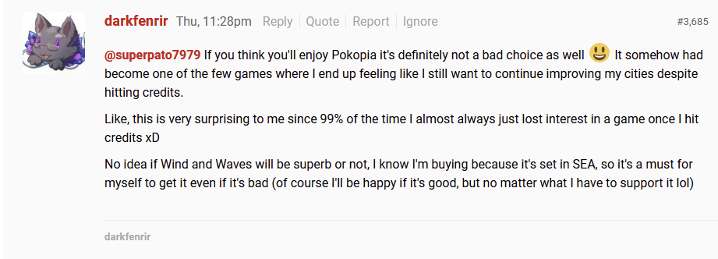
FAUSTO’S NOTES

Slide 11
FAUSTO’S NOTES
CONSUMER VALUES: THEY PRIORITIZE QUALITY AND EXPECT NINTENDO STANDARDS AND SEE A BIG FUTURE FOR THE NINTENDO PRODUCTS AND COMPANY DUE TO THE LARGE INVESTMENT THAT IS BUYING A NEW SWITCH 2
INFLUENCE: USERS ARE VERY WEARY ON FUTURE NEWCOMERS PRODUCT PURCHASES EVEN IF THEY ALREADY OWN IT. THEY EXPLAIN THAT THE CONSOLE AND GAMES MAY NOT BE FOR EVERYONE OR CAN COME WITH SOME TRADE OFFS.
LEADERS: THE LEADERS ARE VERY INFLUENTIAL AND THEIR INPUT IS WORTH LOT THEY CONNECT LOGIC WITH EMOTIONAL SENTIMENT. THE LEADERS TAKE INTO ACCOUNT WHAT YOU SAY AND PROVIDE EVIDENCE AND UNDERSTANDING TO THE QUESTION OR DISCUSSION.
WHAT BRINGS THEM TOGETHER: THE LOVE FOR THE CONSOLE THEY WANT TO SEE IT SUCCEED AND EVERY ONE OF THE NEW GAMES THAT COME WITH IT.
WHAT DRIVES THEM APART: THE SKEPTICISM OF HOW GOOD A GAME WILL BE JUST BASED ON EARLY FOOTAGE AND BIAS ON NINTENDO IP.

Slide 12
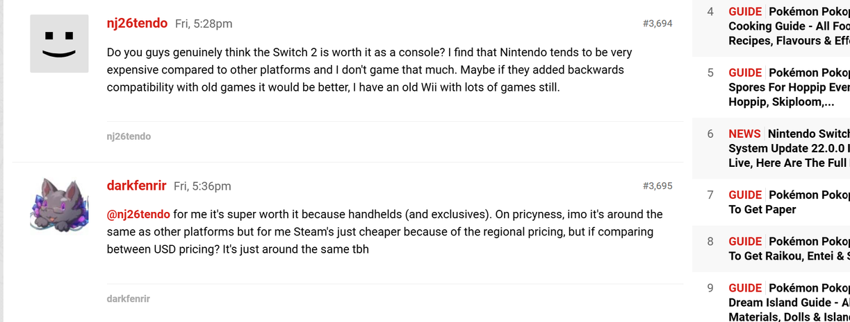
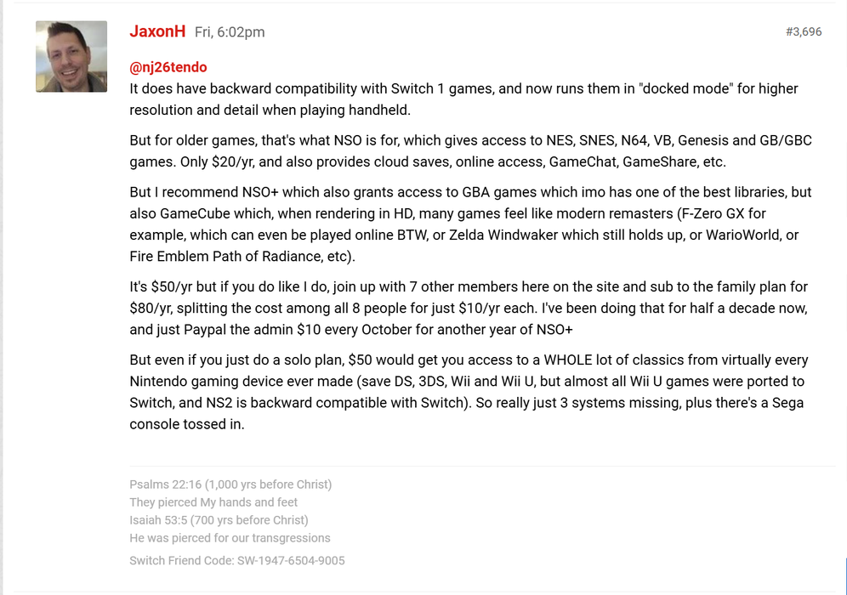
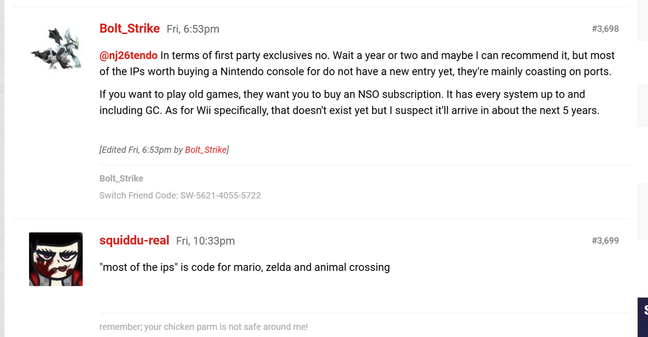
NATHAN’S NOTES

Slide 13
NATHAN’S NOTES
Consumer values:
Consumers value the availability of games via the various consoles and platforms. I mentioned backward compatibility and got a clear response showing that this is a concern currently being addressed.
Influence:
I found that they did influence me more than I influenced them as I went in there asking a question. I got mixed opinions on whether the Switch 2 is worth it, but my opinion has been reinforced that I don’t need it as of now.
Leaders:
There were clear opinion leaders in the thread due to participation and apparent knowledge. He responded to my comment with paragraphs of information.
What brings them together:
A strong sense of connection as a community, being anti big corporation. Not super fanboy, much more balanced discussion.
What drives them apart:
Different opinions on the current value of the Nintendo Switch 2 platform for the majority of casual gamers.

Slide 14
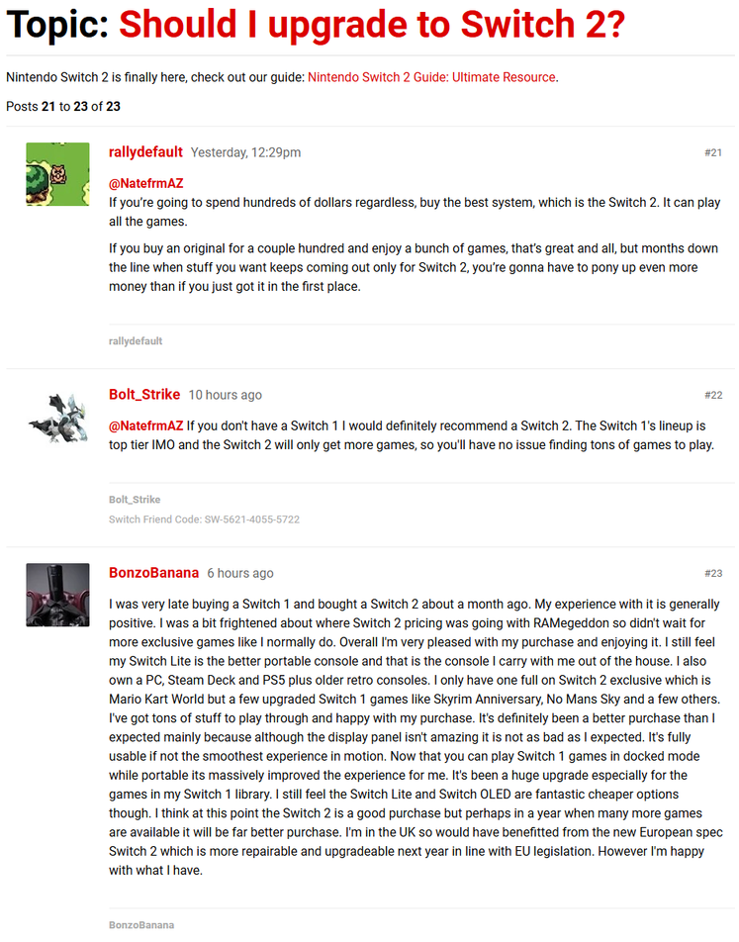
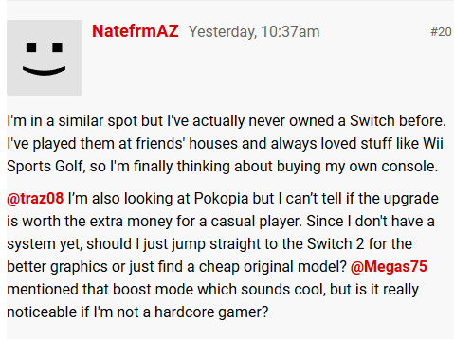
NATE’S NOTES

Slide 15
NATE’S NOTES
Consumer Values: Prioritizing long-term value and future-proofing over initial savings. Users value "buy once, buy right" to avoid needing a second upgrade later.
Influence: Peer advice is centered on preventing "buyer's remorse." Experienced users successfully steer newcomers toward the newest hardware by highlighting potential future software locks.
Leaders: "Multi-platform owners" act as the primary influencers. These users provide credibility by comparing the Switch 2 to other high-end tech like the PS5 or Steam Deck.
What brings them together: A shared loyalty to the Nintendo library. The common ground is the "top-tier" games list that bridges the gap between old and new hardware.
What drives them apart: Technical vs. Casual priorities. Hardcore users focus on specs like RAM and repairability, while casual users are more concerned with simple portability and entry price.

Slide 16
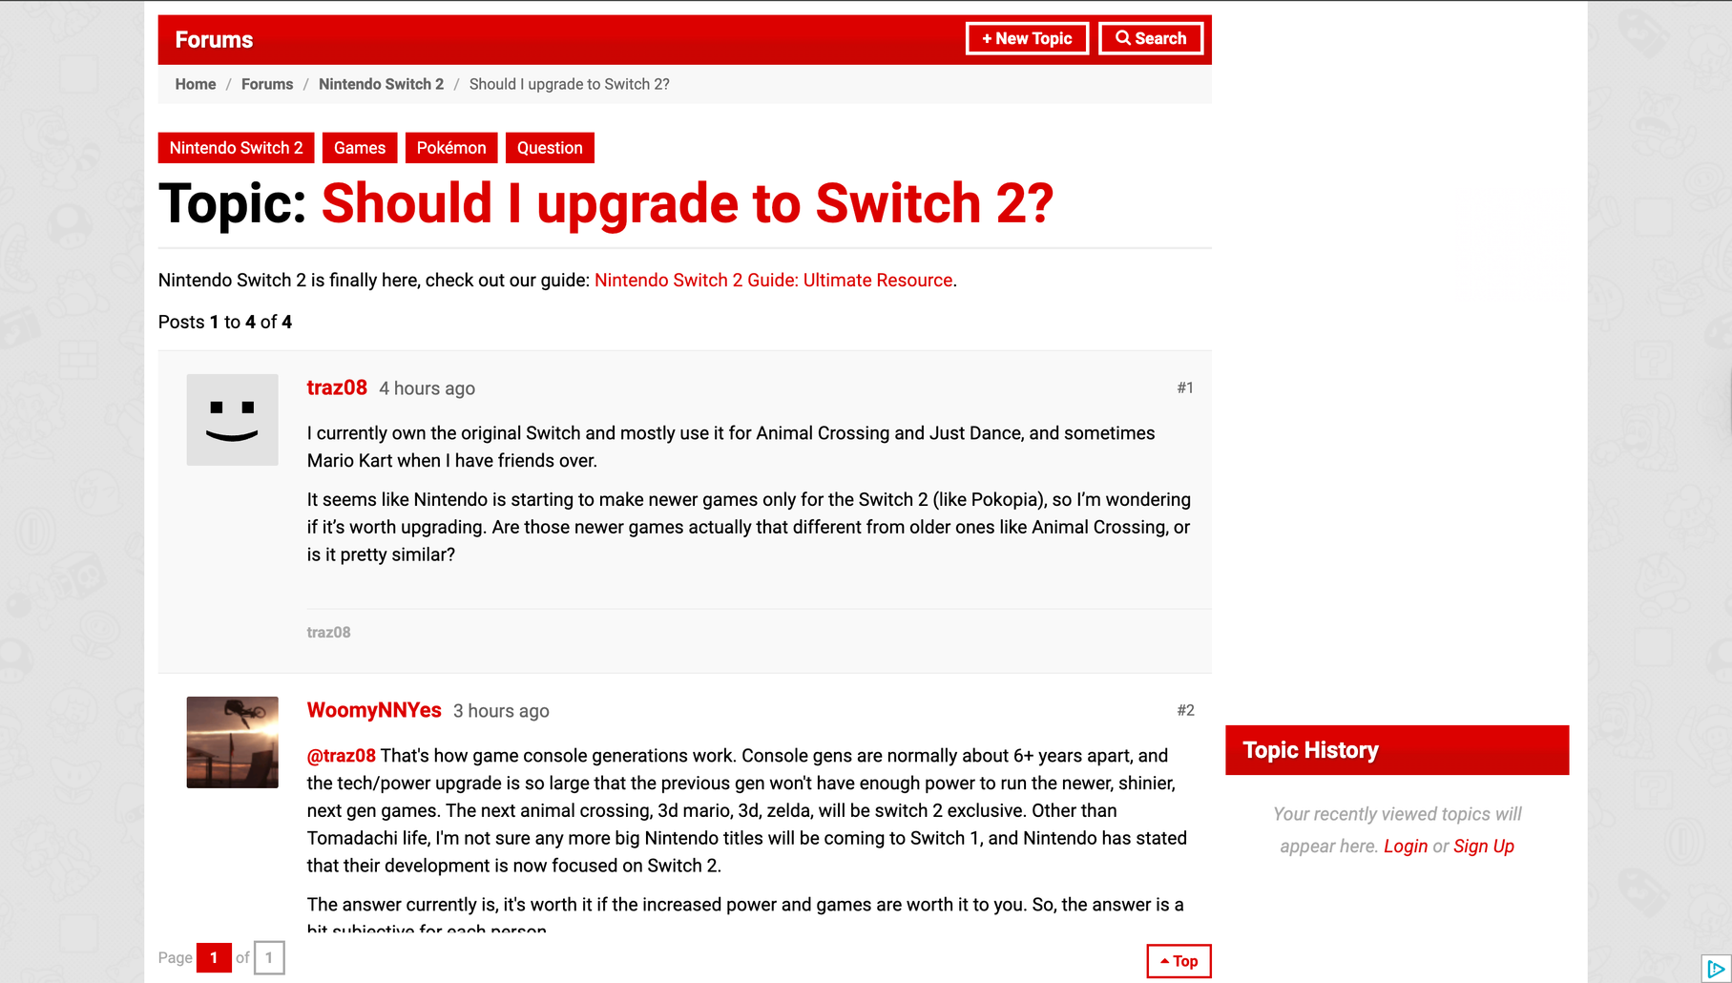
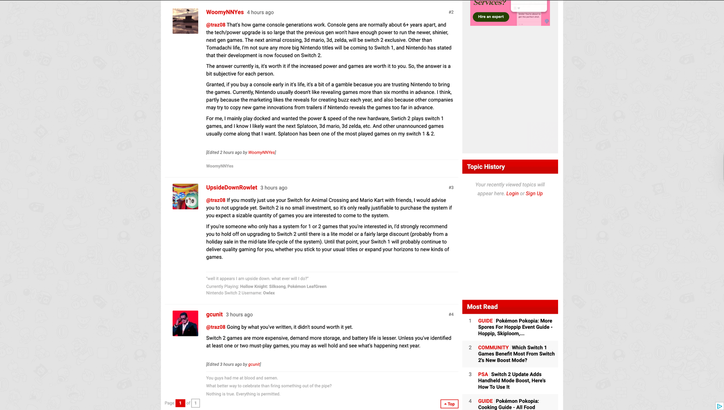
TAYLOR’S NOTES
My post - traz08
Responses

Slide 17
TAYLOR’S NOTES
My Oberservations
Consumer values: People mostly care about price, what games are available, and how much they’ll actually use it, rather than having the newest tech. Something I didn’t realize is that people are buying based on what they think will come out, not just what’s available now.
Influence: The replies influenced me more. I’m leaning toward waiting now after seeing their reasoning and how many people said to hold off unless there’s a must-have game.
Leaders: It seems like more experienced gamers kind of lead the conversation by explaining things and giving advice. There are staff/admins, but it wasn’t super clear who they were.
What brings them together: They’re allNintendo/Switch players and know the same popular games, so it’s easy to relate. They also share the same situation of deciding whether to upgrade, which makes the discussion feel relevant to everyone.
What drives them apart: It mostly comes down to play style (casual vs. more serious gamers), how they see the value, and whether they want to buy now or wait. Some people are okay taking the risk early, while others really want proof it’s worth it first.

Slide 18
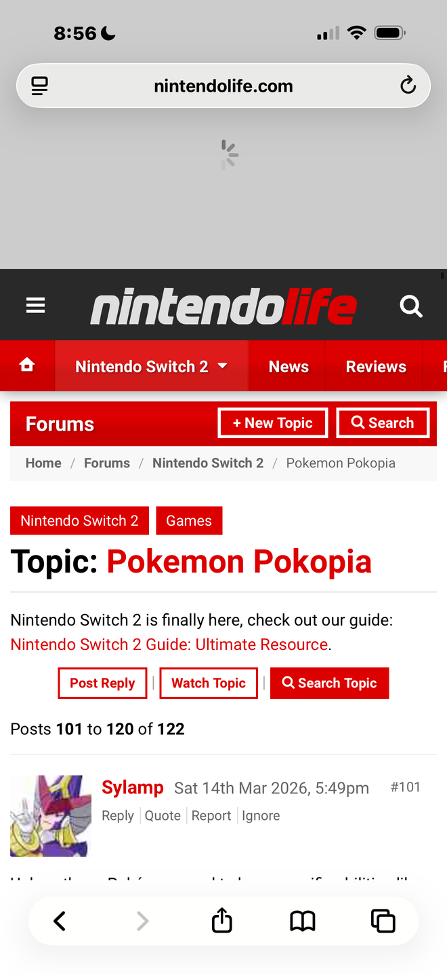
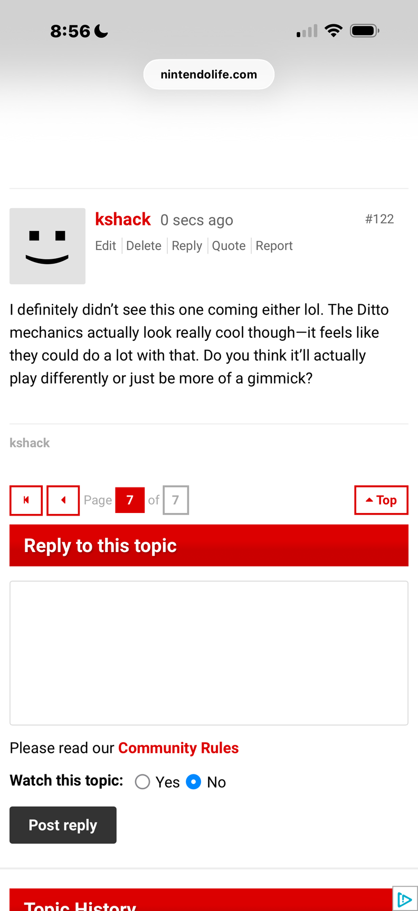
KAYLEIGH’S NOTES

Slide 19
KAYLEIGH NOTES
My Oberservations
Consumer values: Consumers really value innovation and unique gameplay, especially with new features like the Ditto mechanics. They’re excited by creativity, but at the same time they still care about whether the feature actually adds depth or just feels like a gimmick. I also noticed they rely a lot on past Pokémon games to judge whether something will be successful.
Influence: The replies influenced me by making me think more critically about the feature. At first it just looked cool, but after reading responses, I started considering whether it would actually change gameplay in a meaningful way or become repetitive over time.
Leaders: Leaders in the forum seemed to be users who gave more detailed explanations or comparisons to past games. The people who sounded the most knowledgeable or had strong opinions tended to get more responses and kind of guided the direction of the discussion.
What brings them together: What brings them together is a shared interest in Pokémon and excitement around new releases. They all understand the mechanics and references, so it creates a strong sense of community and makes it easy for people to jump into conversations.
What drives them apart: What drives them apart is mainly their expectations—some people are more optimistic and excited about new ideas, while others are more skeptical and focused on whether it will actually be well executed. So there’s a divide between people who are open to change and people who want proven quality.

Slide 20
HEAVEN’S NOTES
Consumer Values: Users in this community value title performance and have expectations for how games are made. They also seem to value knowledge as they all talk about the games themselves with their experience and their opinions of topics.
Influence: Since I already own a Switch 2, it didn't really influence me to buy a Switch 2 but I was more influenced to buy different games that I have heard of but haven't actually bought and played.
Leaders: Many members are very vocal but aren't necessarily admins or mods for the actual website. It seemed that the more regular commenters have been around for a long time. While they aren't direct leaders, they do seem have to have the most amount of influence, and people generally tend to listen to them.
What brings them together: The Nintendo brand and the different games that they all play. They seem to bond and share regularly about what they experience and how they feel. They like sharing knowledge that they have and like giving opinions and responding to each other.
What drives them apart: Their expectations of what they want in terms of games. Some people seem to enjoy some games and others don't but they are generally cordial and respectfully respond to each other. They have differing opinions on how they felt about particular games.

Slide 21
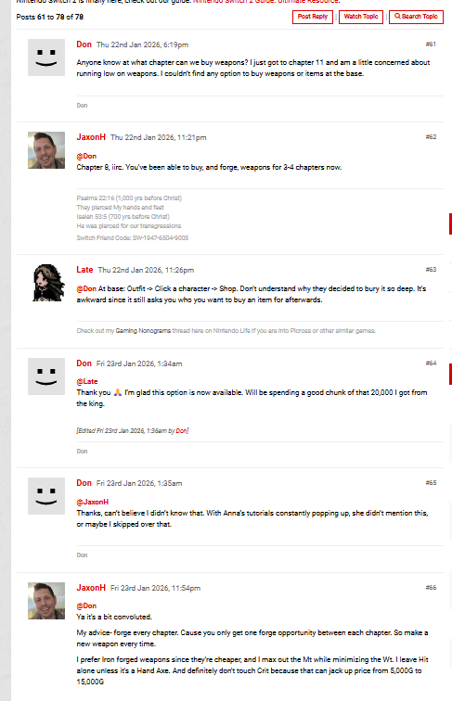
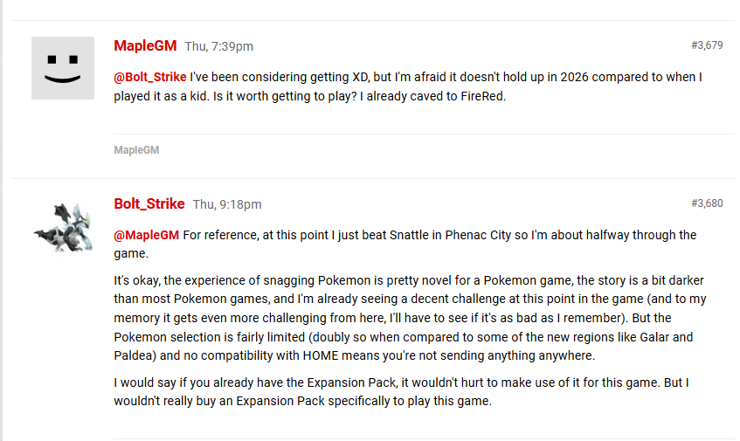
HEAVEN’S NOTES

Slide 22
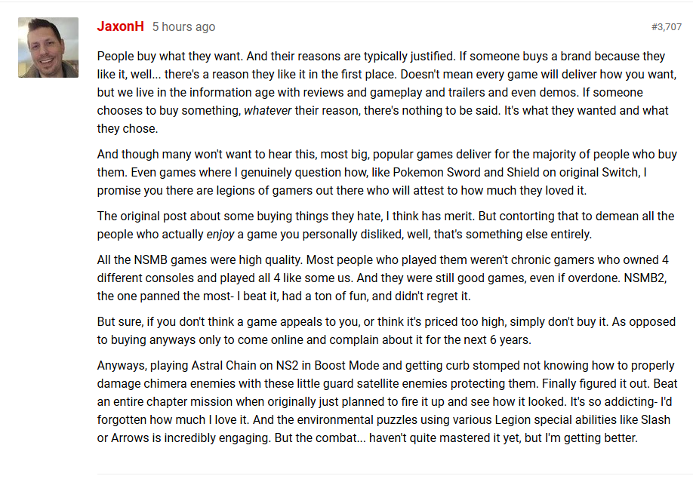
HEAVEN’S NOTES

